Slide 1


Git and GitHub
Version Control Systems
SoftUni Team
Technical Trainers
Software University
https://softuni.bg

Slide 2
Table of Contents
Software Configuration Management (SCM)
Source Control Repositories
Concepts, Workflow, Terminology
Introduction to Git
Basic Commands: clone, pull, add, commit, push
Introduction to GitHub
Creating Repo → Clone → Edit → Commit → Push

Slide 3
Have a Question?
sli.do
#fund-common

Slide 4
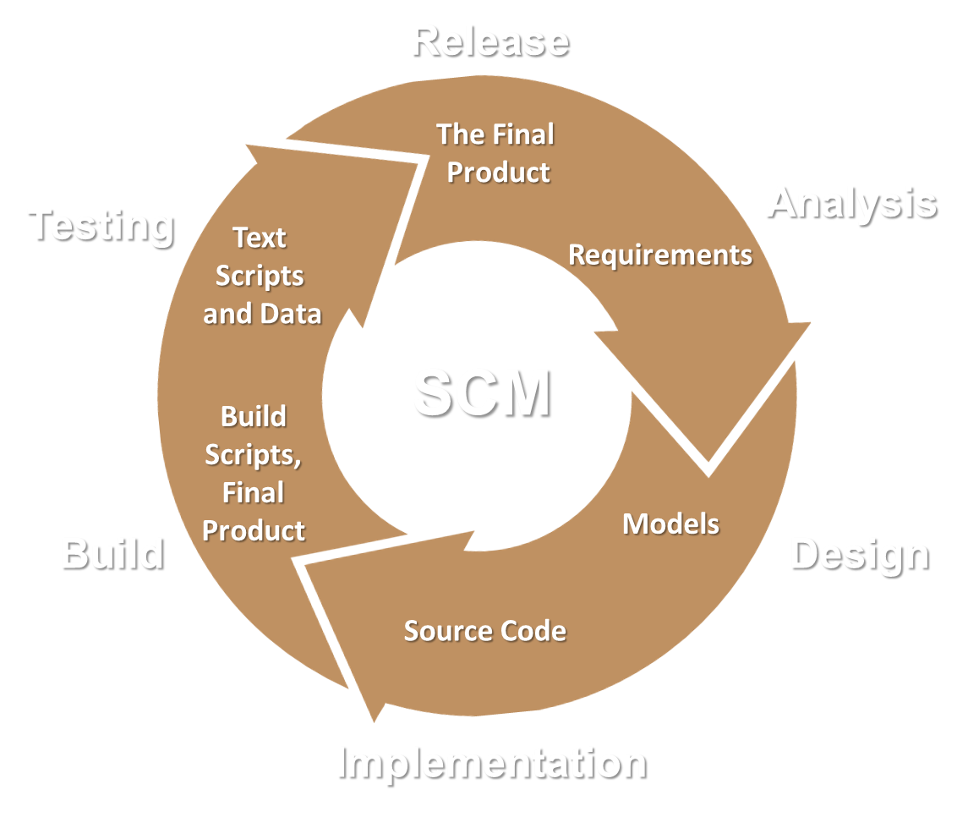
Software Configuration Management
Source Control Systems

Slide 5
Software Configuration Management
Version Control ≈ Software Configuration Management (SCM)
A software engineering discipline
Consists of techniques, practices and tools for working in a team on shared source code and files
Mechanisms to manage, control and track changes
Defines the process of change management
Keeps track on the changes in the project over time
Solves conflicts in the concurrent changes
5

Slide 6
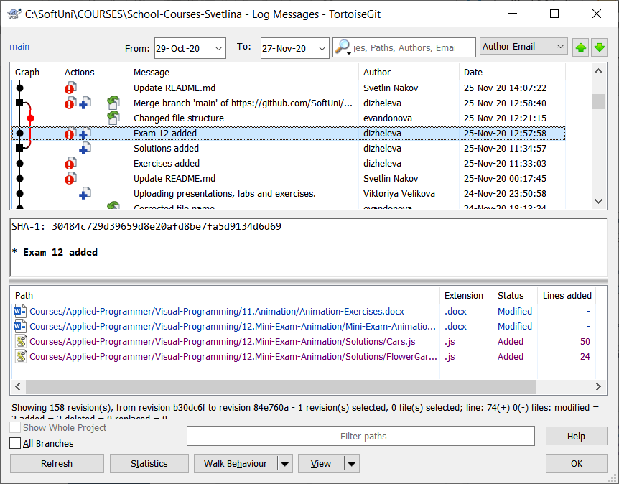
Change Log
Version control systems keep their own change log (version history):
Who?
When?
Why?
What has changed?
Old versions could be restored
6

Slide 7
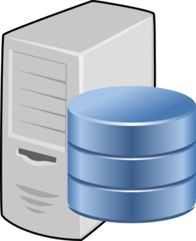
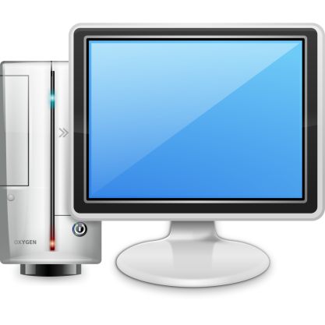
Vocabulary: Repository (Repo)
Repo: holds the project assets in a remote server
Remote
Local

Slide 8
Vocabulary: Clone
Clone: downloads a local copy of the project
Remote
Clone
Local

Slide 9

Vocabulary: Commit
Commit: saves the changes locally
Remote
Local

Slide 10


Vocabulary: Sync (Pull / Push)
Pull: take the changes from the remote repo
Merge the changes in the local file system
Eventually a conflict can happen
Push: send local changes to the remote repo
Remote
Merge
Push
Pull
Local
Conflict

Slide 11
Vocabulary: Branch
master
master
custom-branch

Slide 12
Vocabulary: Merge Branches
conflict
master
master
resolve
custom-branch

Slide 13





Example: Branches
merge
master
master
new feature

Slide 14
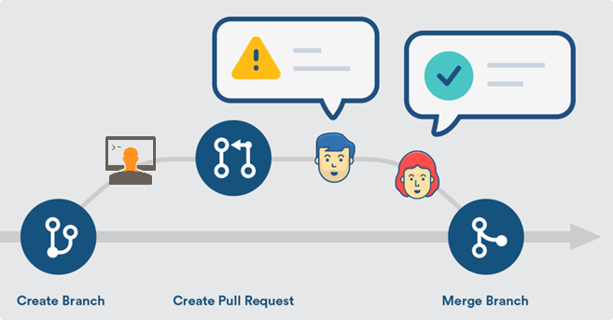
Pull Request

Slide 15

Git
World's #1 Source Control System

Slide 16
What is Git?
Git == distributed source-control system
The most popular in the world
Free, open-source software
Works with local and remote repositories
Git bash – command line interface for Git
Runs on Linux, macOS and Windows (msysGit)
https://git-scm.com
16

Slide 17
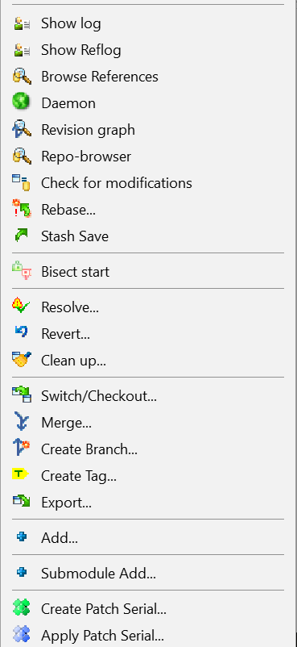
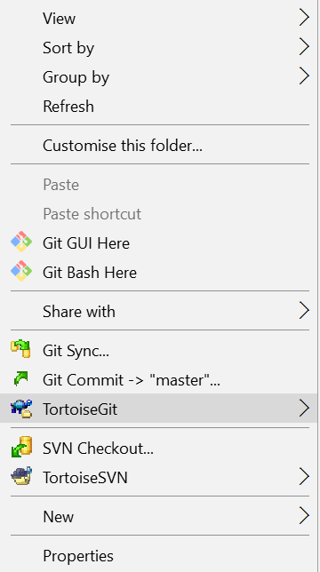
Using Git
Console-based git client (Git bash)
git (console command)
Windows GUI client – TortoiseGit
https://tortoisegit.org/download
Visual Studio / Eclipse plug-ins
GitHub Desktop client
https://desktop.github.com

Slide 18
Installing Git
MsysGit installation on Windows
https://git-scm.com/downloads
Options to select (they should be selected by default)
"Use Git Bash Only"
"Checkout Windows-style, Commit Unix-style Endings"
Git installation on Linux:
sudo apt-get install git
18

Slide 19
Basic Git Commands (1)
Cloning an existing Git repository
Fetch and merge the latest changes from the remote repository
Preparing (adding / selecting) files for a commit
Committing to the local repository
git clone [remote url]
git pull
git add [filename] ("git add ." adds everything)
git commit –m "[your message here]"

Slide 20
Basic Git Commands (2)
Check the status of your local repository (see the local changes)
Creating a new local repository (in the current directory)
Creating a remote (assign a short name for remote Git URL)
Pushing to a remote (send changes to the remote repository)
git status
git init
git remote add [remote name] [remote url]
git push [remote name] [local name]

Slide 21
Git: Live Demo
Checkout → Modify → Commit → Push

Slide 22

GitHub
World's #1 Source Code Hosting Platform

Slide 23
What is GitHub?
GitHub is the world's #1 source code hosting site
Free for open-source projects
Paid plans for private repositories
GitHub provides:
Git repository for shared source code
Issue tracker (bug tracker)
Project board (Kanban style)
Wiki pages (documentation)
Build system, releases, analytics
23

Slide 24
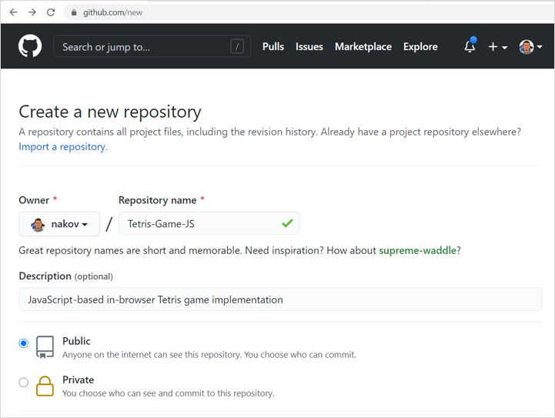
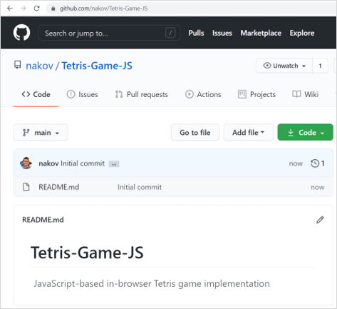
Creating a GitHub Repository

Slide 25
GitHub – Example
Clone a repository from GitHub
Modify local files
Commit changes (local)
Push the changes to GitHub
git clone https://github.com/SoftUni/playground
notepad README.md
git add . & git commit -m "Added something"
git push
Notes:
Let's illustrate how we can use Git and GitHub through a few examples.
We shall clone a GitHub repository, edit a local file, commit the local changes and push them to GitHub.
We work with this sample Git repository: https://github.com/SoftUni/playground
First, let's look at it.
It holds several files: code + documentation.
As a concept, source control repositories hold the source code and other assets of a software project.
We first clone the sample repository to a local directory, using the "git clone" command.
We must have pre-installed the "Git" client software on the local machine.
We start the system console (which is also called "terminal window" or "command prompt").
Then we type the following command at the command line:
git clone https://github.com/SoftUni/playground
This will create a local copy of the specified repository in the "playground" subdirectory in the current directory.
Now we can modify а local file, for example the file "README.md".
We can use a text editor of choice, such as "Notepad".
We can open the file with Notepad by the following command:
notepad README.md
Now add a new line in the file and save it.
Now we have a modified file on the local disk.
We want to commit the pending changes,
so that they enter the local repository and are tracked in the version control system.
We run the following command at the console:
git add . & git commit -m "Added something"
This command adds any new files to the repository and commits all pending changes.
When we commit the changes, we need to leave a message (an explanation of the changes we make).
Now we have a local repository, which holds changes.
We can change files and commit our work many times.
These changes are still not sent to GitHub.
To send the local commits to the remote repository at GitGub, we can execute the following command:
git push
This command needs the current Git user to have permissions to write in the remote repository.
It may ask for username and password or other method of authentication.
Now we can open the repository from the GitHub web site and see the changes:
We can see the content of the changed files.
We can also review the commits (the change log) and what was changed in each commit.
Please focus on the concepts, rather than on the commands and their parameters.
The concepts here are that source control systems keep the source code in a remote repositories,
and we can clone these repositories, edit files, commit the changes and push the commits to the origin repository.
This workflow allows different team members to work together on a shared source code.

Slide 26
GitHub: Live Demo
Create Repo → Edit Files → Checkout → Push

Slide 27

Live Exercises
Working with Git and GitHub

Slide 28

Summary
…
…
…
Use version control systems to work in a team
Keep the code in a central repository
Handle merge conflicts with ease
Important Git commands:
clone, add, commit, pull, push
GitHub == the world's most used software project hosting platform
Git repository, issue tracker, Kanban board, Wiki

Slide 29
Questions?
Notes:
29

Slide 30
Trainings @ Software University (SoftUni)
Software University – High-Quality Education, Profession and Job for Software Developers
softuni.bg, softuni.org
Software University Foundation
softuni.foundation
Software University @ Facebook
facebook.com/SoftwareUniversity
Software University Forums
forum.softuni.bg
30
Notes:
30

Slide 31

License
This course (slides, examples, demos, exercises, homework, documents, videos and other assets) is copyrighted content
Unauthorized copy, reproduction or use is illegal
© SoftUni – https://softuni.org
© Software University – https://softuni.bg
Notes:
31

